Slide 1



Slide 2

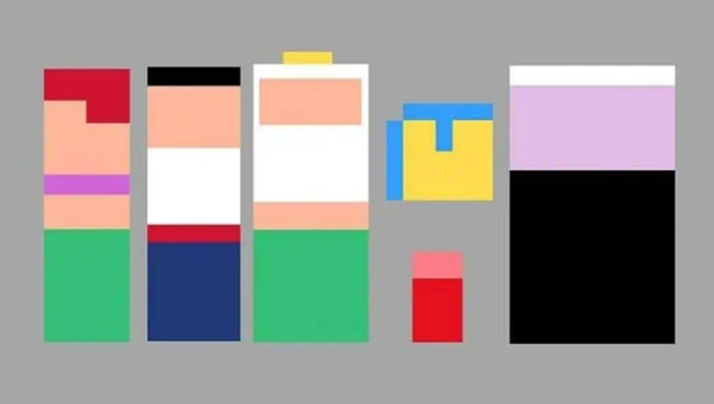

Slide 3
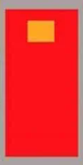
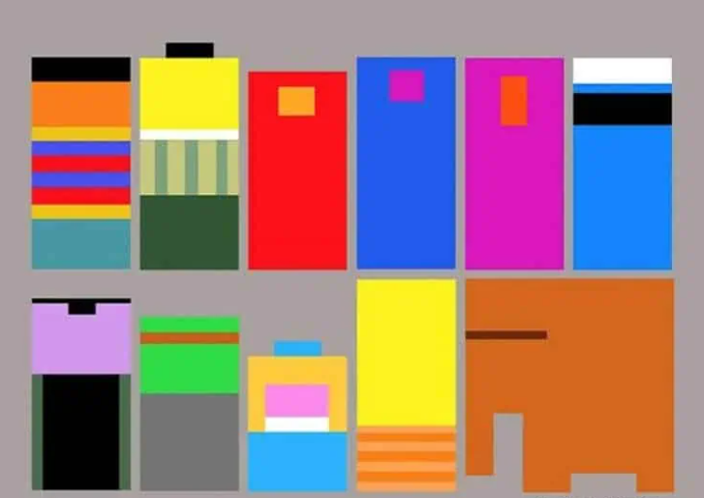

Slide 4




Jeff Victor

Slide 5
Abstract Art vs Minimalism
-Abstract Art: emphasis on visual elements such as form, line, and color to convey emotions or ideas. It does not intend to portray an accurate representation, but rather to invoke emotion.
-Minimalism: a subset of abstract art that emphasizes the physical presence of the actual artwork. It focuses on simplicity, the reduction of form, and avoided narrative and symbolism.
Hard-edge: sharp, precise, contours between color areas.
Color-field painting: art style defined by large, flat expanses of color, often devoid of gesture and brushstrokes.
Reductive art: art style that strips subject matter down to its essential elements

Slide 6


Slide 7
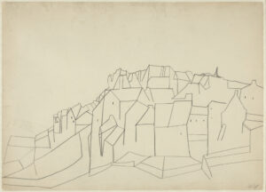
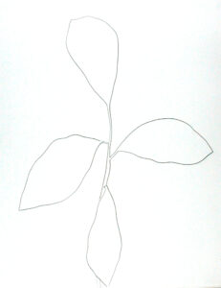
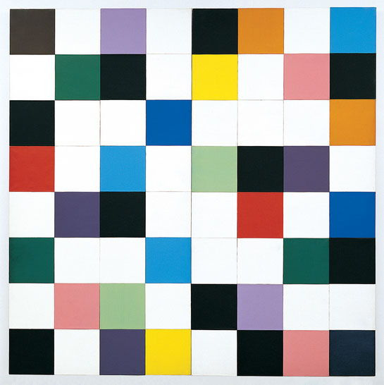
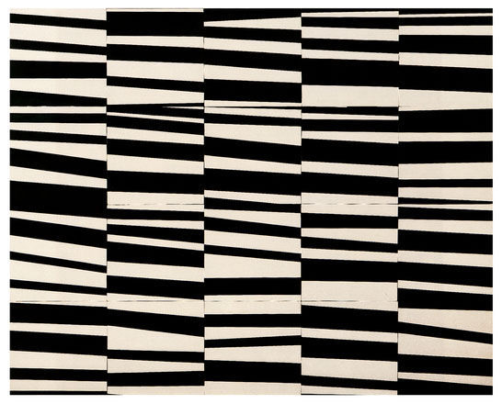
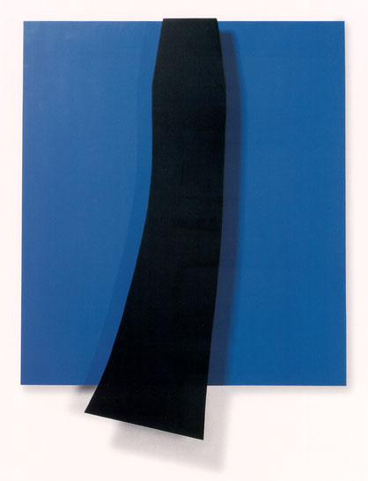
Ellsworth Kelly

Slide 8
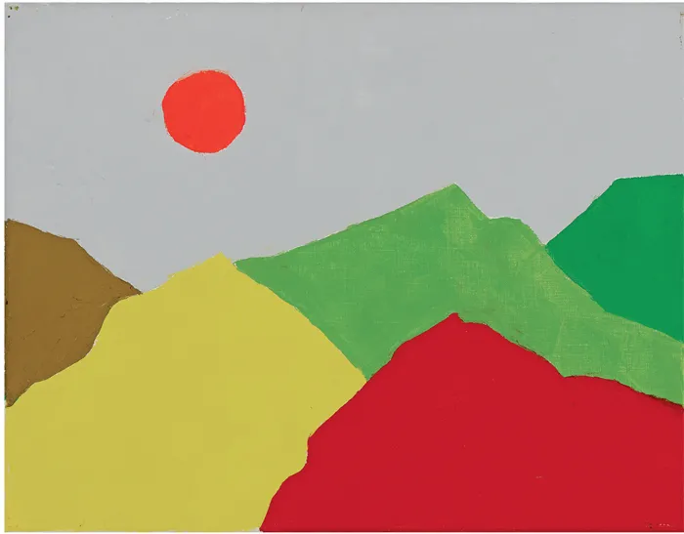
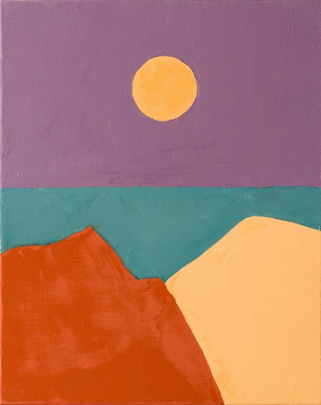
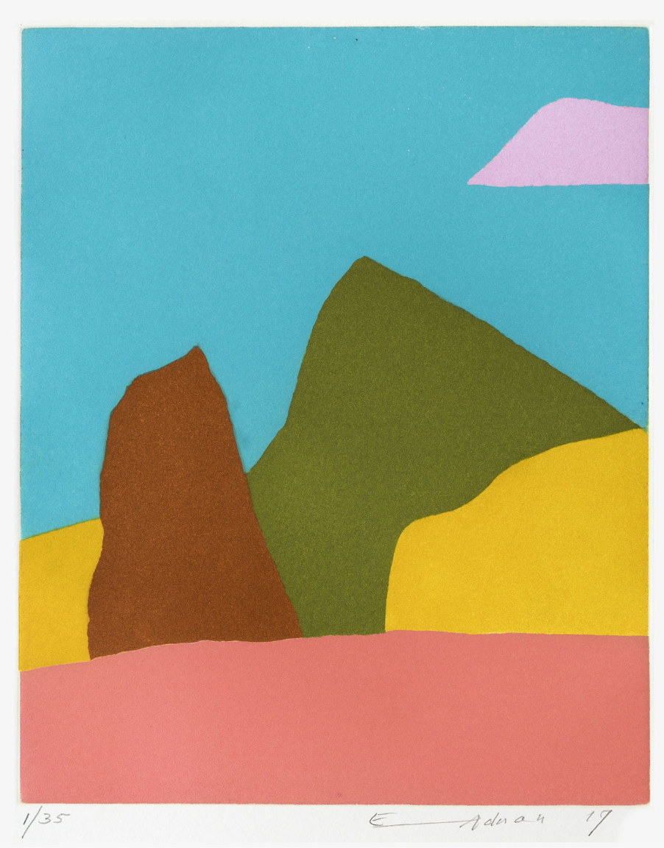
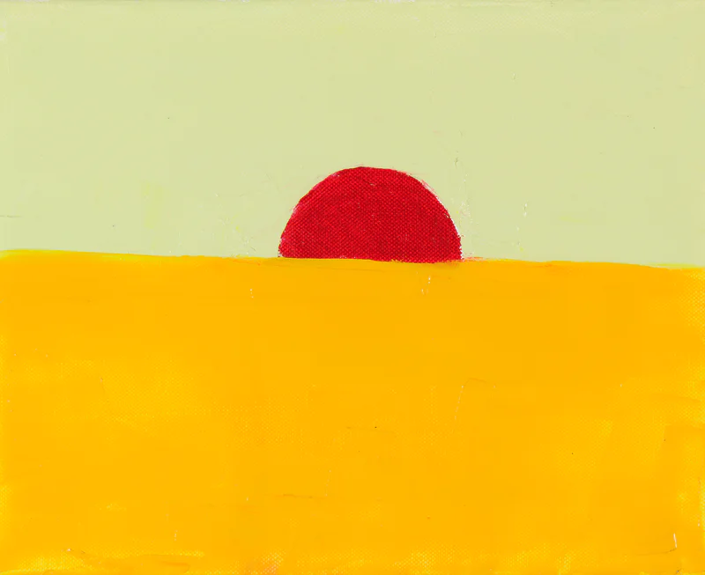
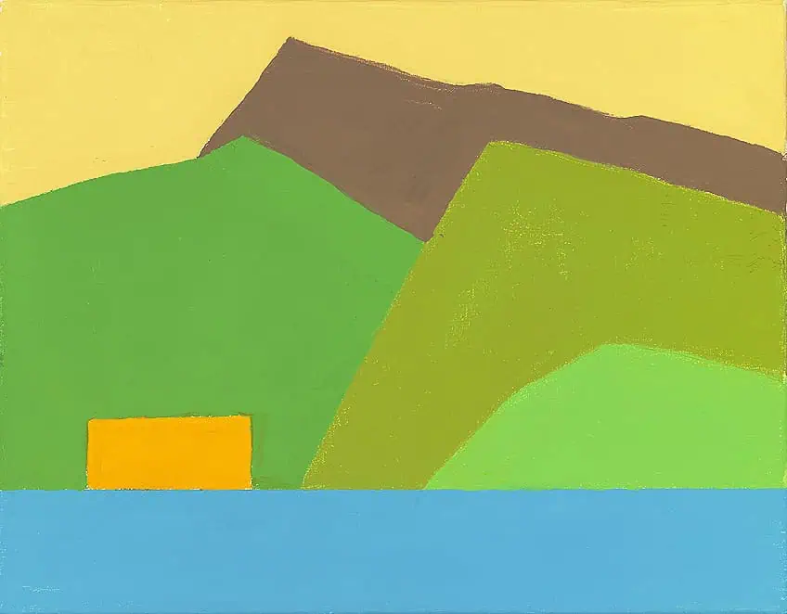
Etel Adnan

Slide 9
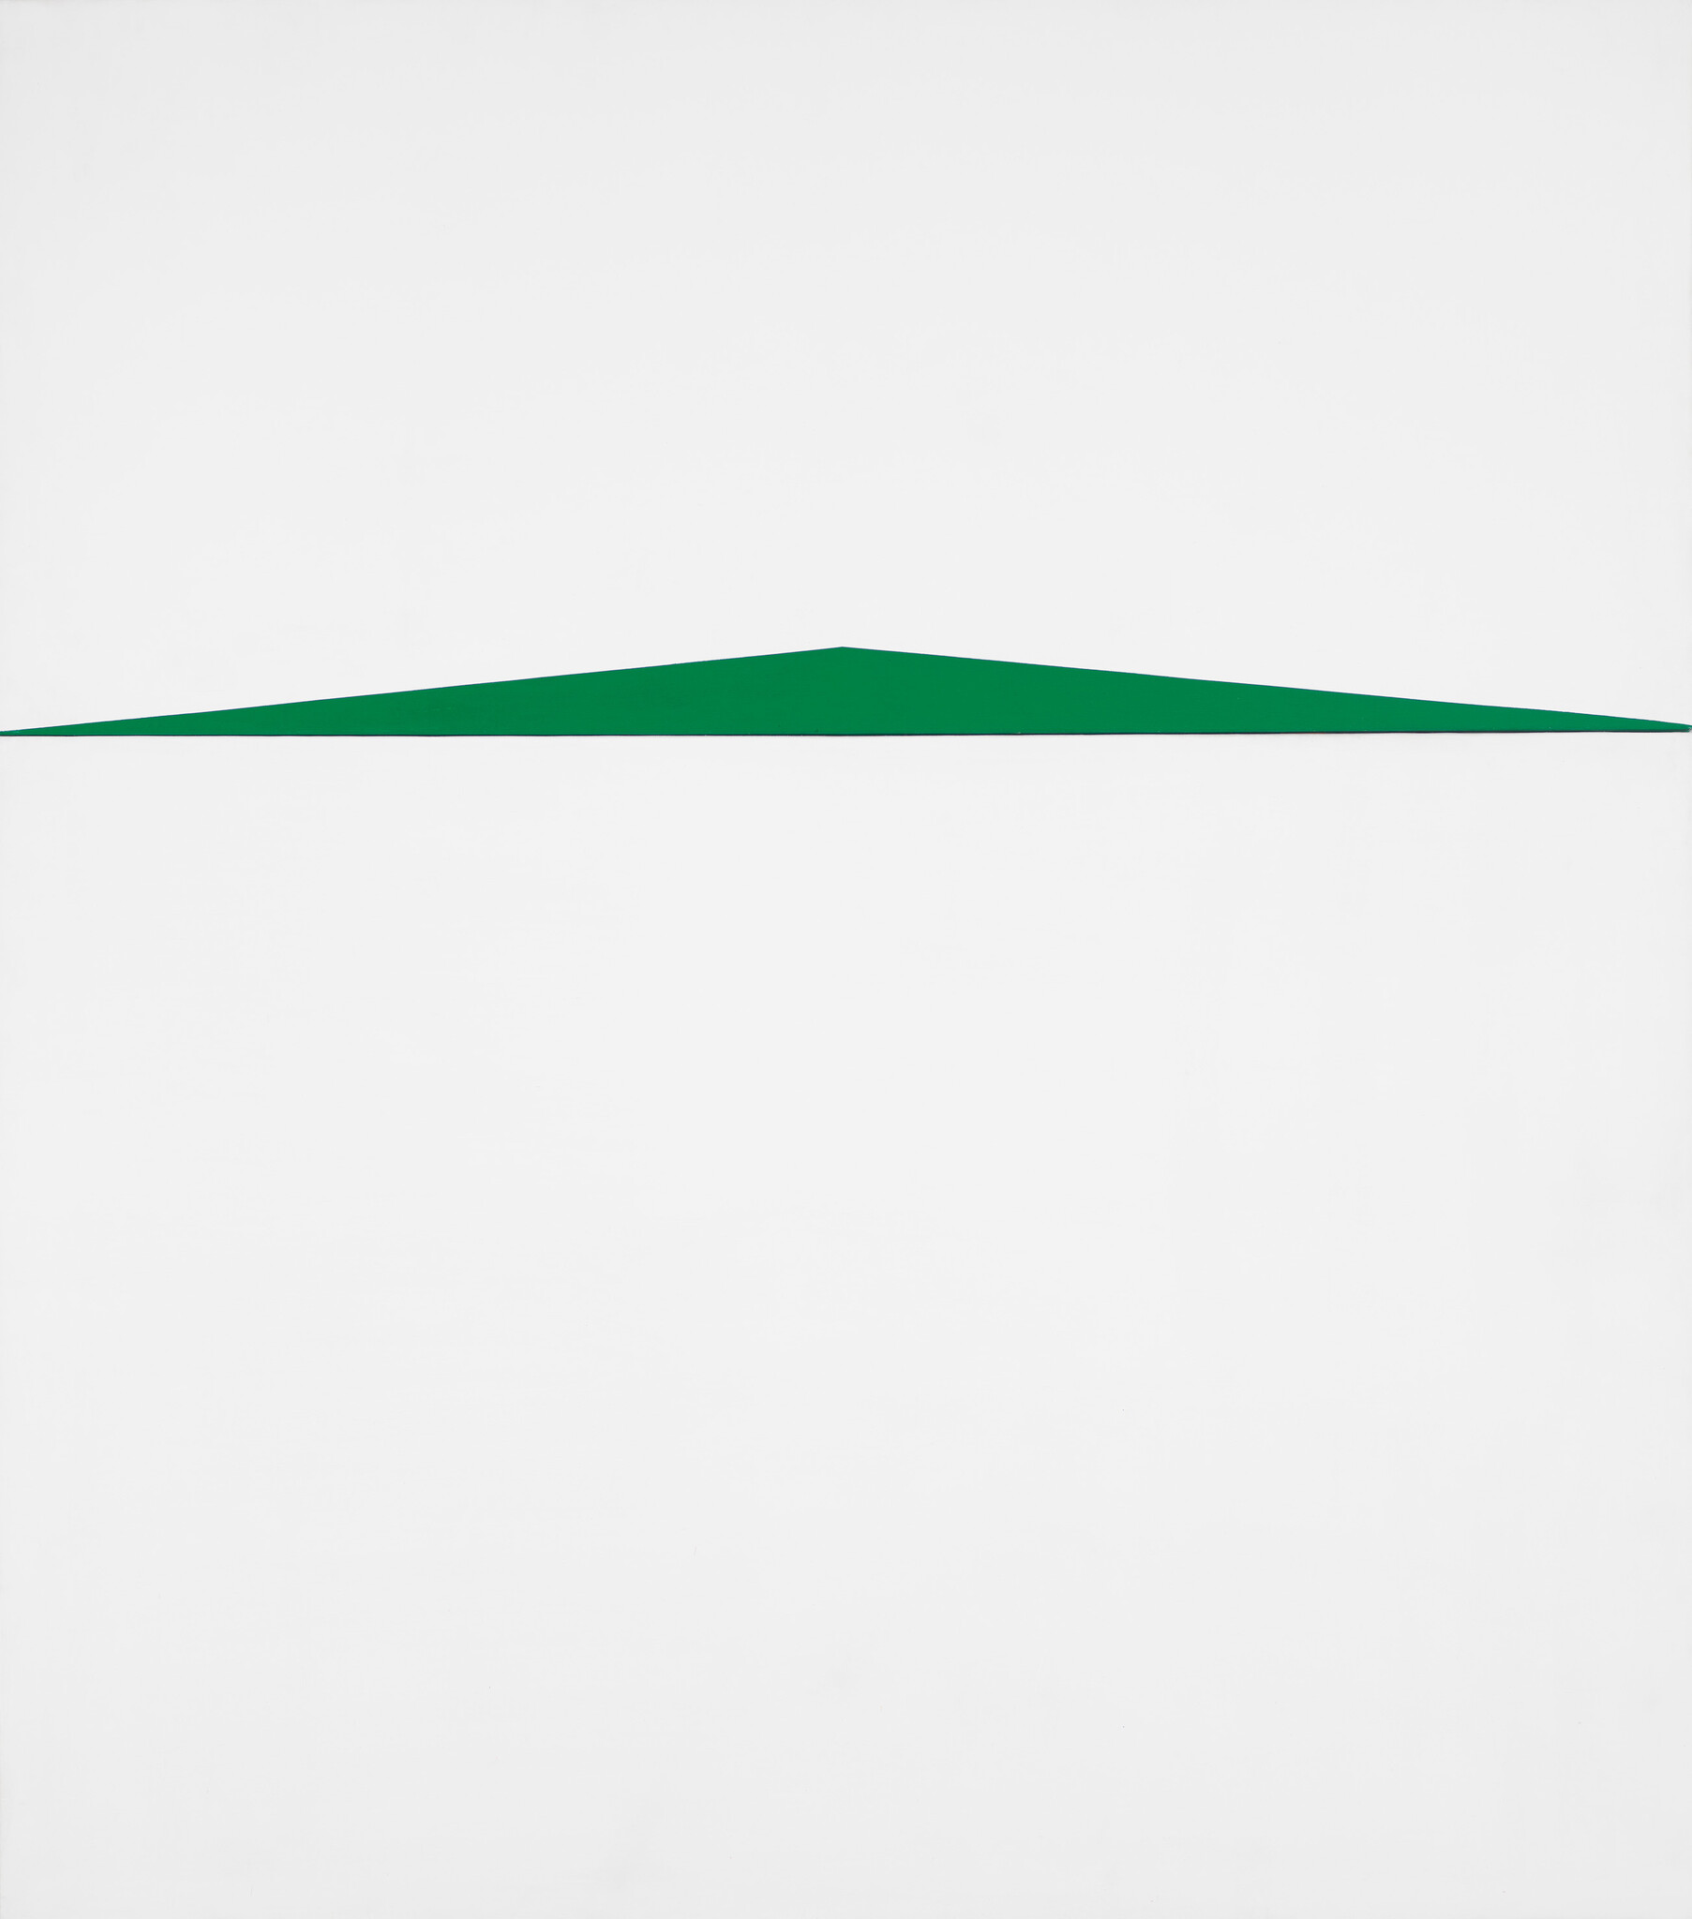
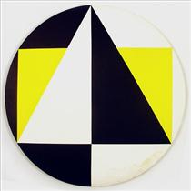
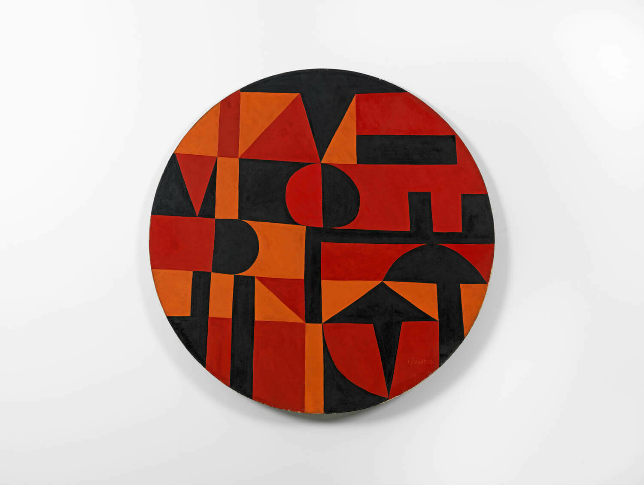
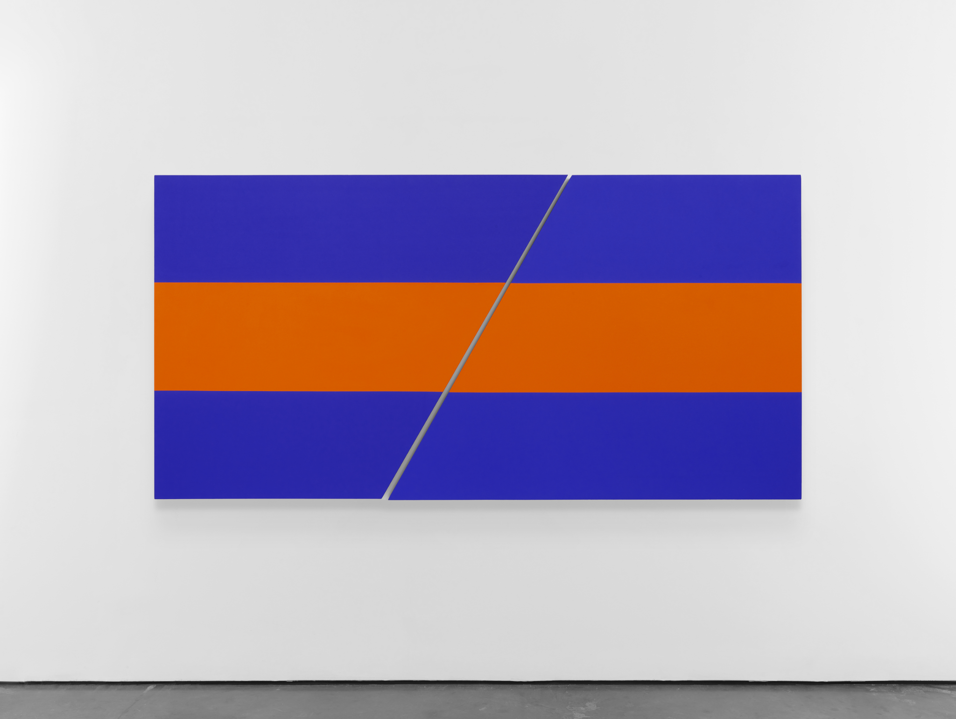
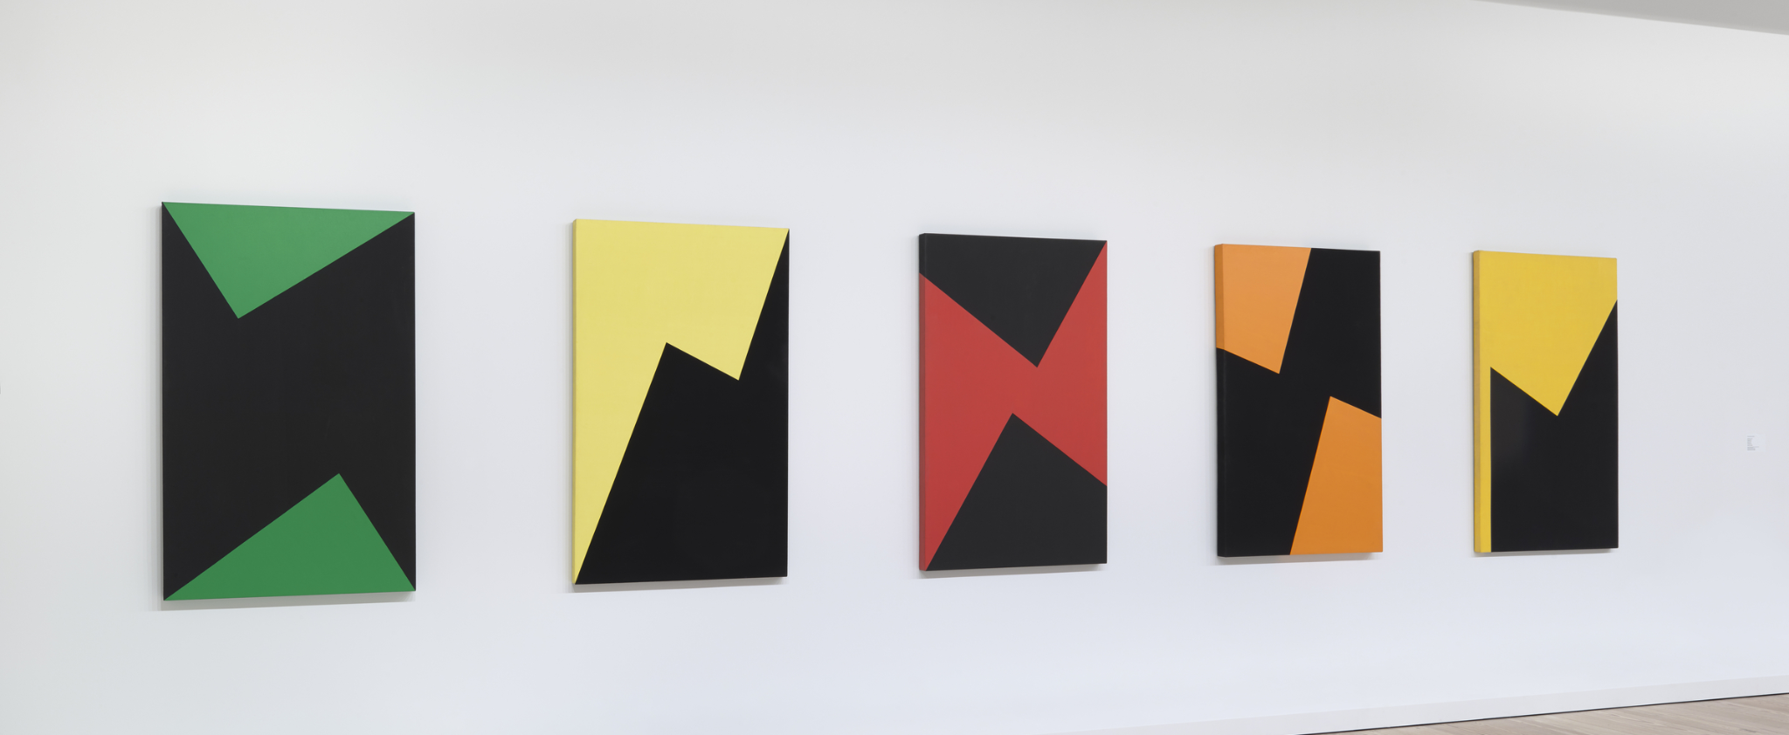
Carmen Herrera

Slide 10
Project Brief: Color, Contrast, and Space in Abstract Minimalism
Choose a subject you wish to portray. This can be landscapes, objects, or people. Reduce your subject matter to geometric shapes and flat colors. Use sketches to help you create your composition and color scheme. Then, create a series of four of your subject matter, varying the color of your compositional elements, the composition itself, or where the objects appear in space.
Materials: You must use gouache for this assignment. However, you may either paint your shapes directly on canvas/canvas paper OR you may paint swatches and cut out your geometric shapes from the swatches. You may use painter’s tape to help you if you are painting directly on canvas.

Slide 11
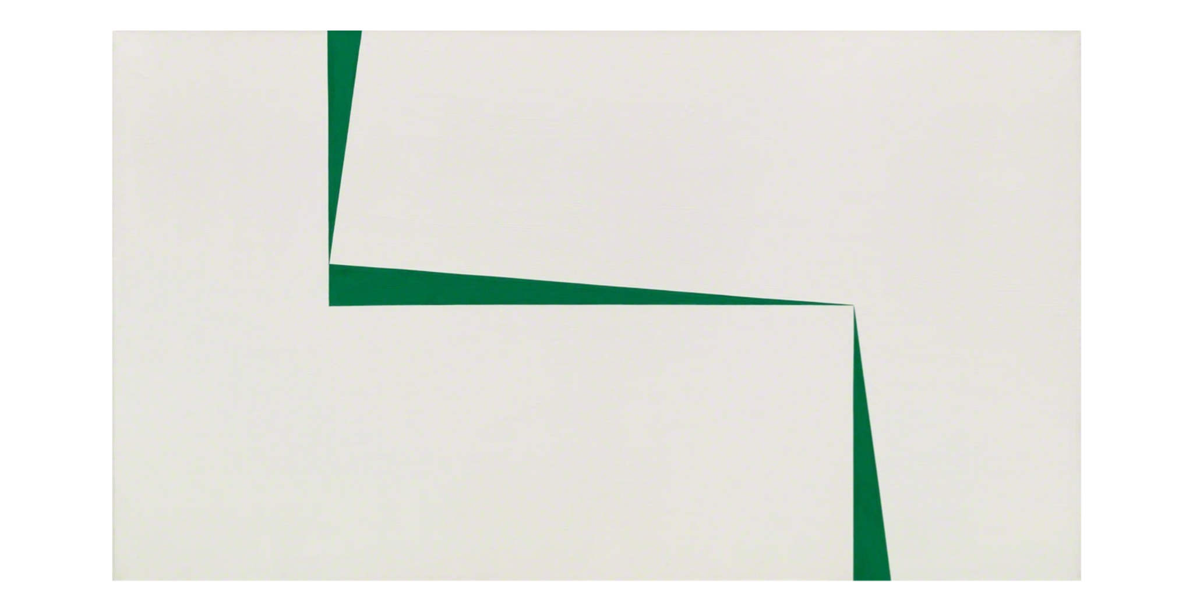
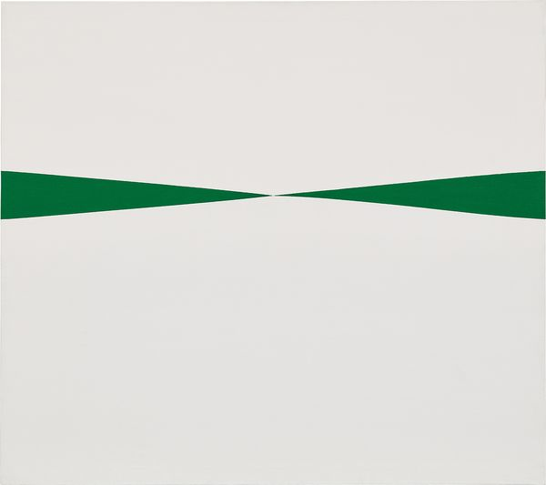
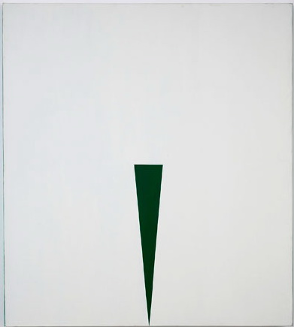
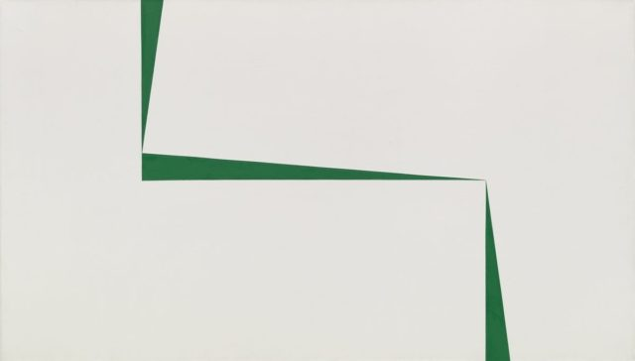
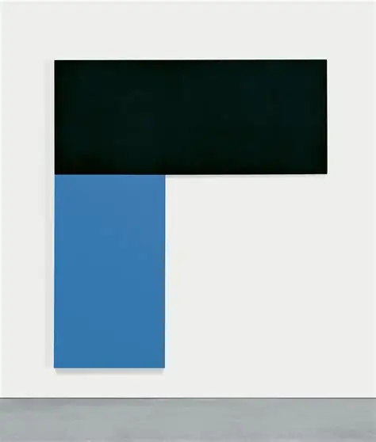
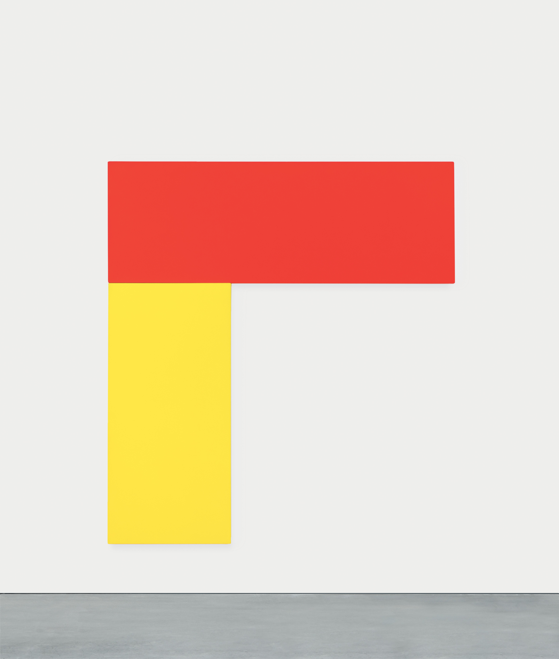
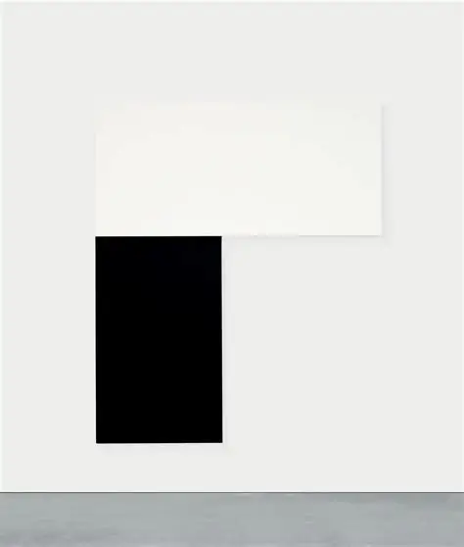
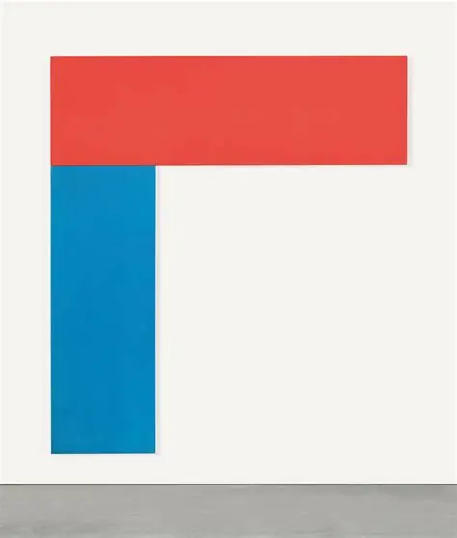
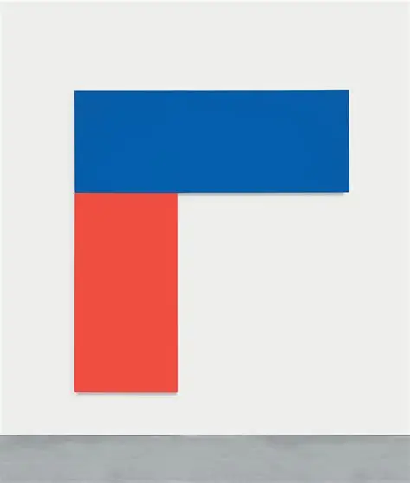
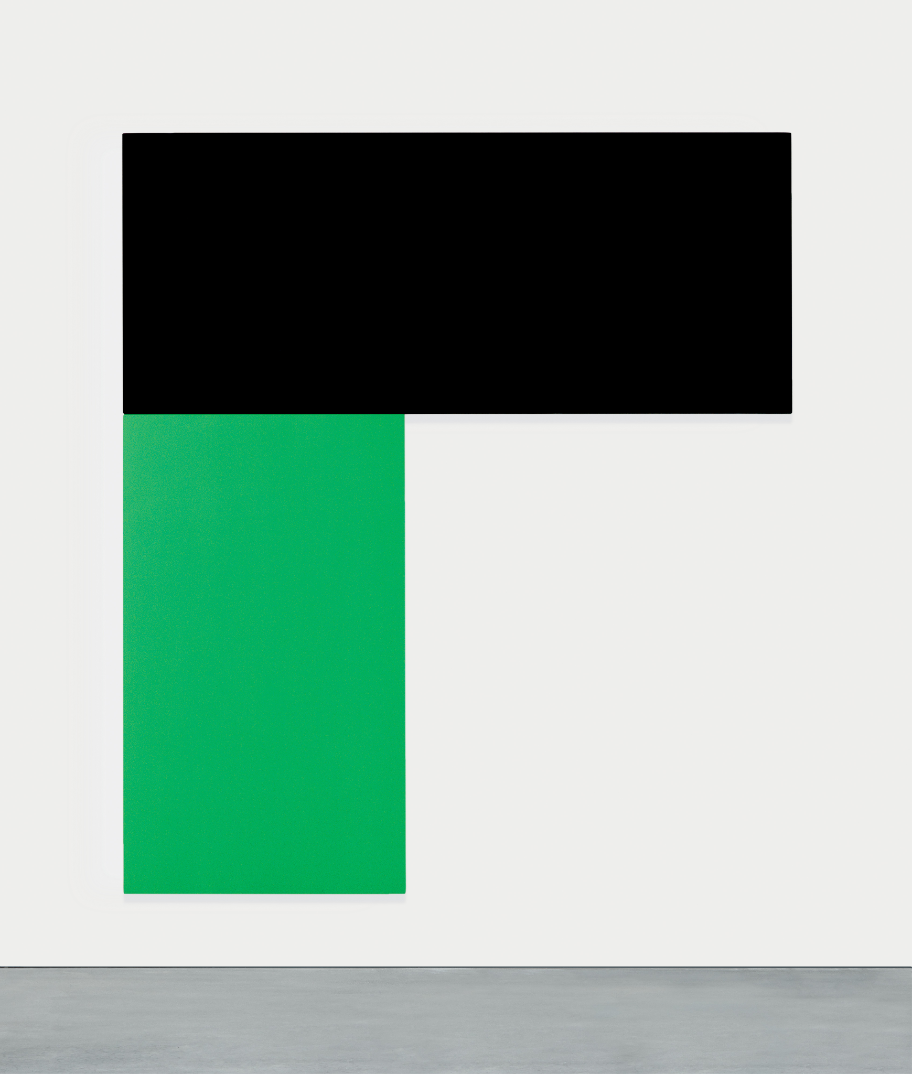
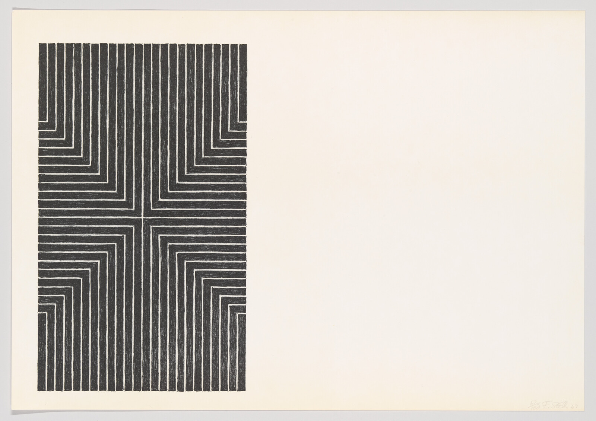
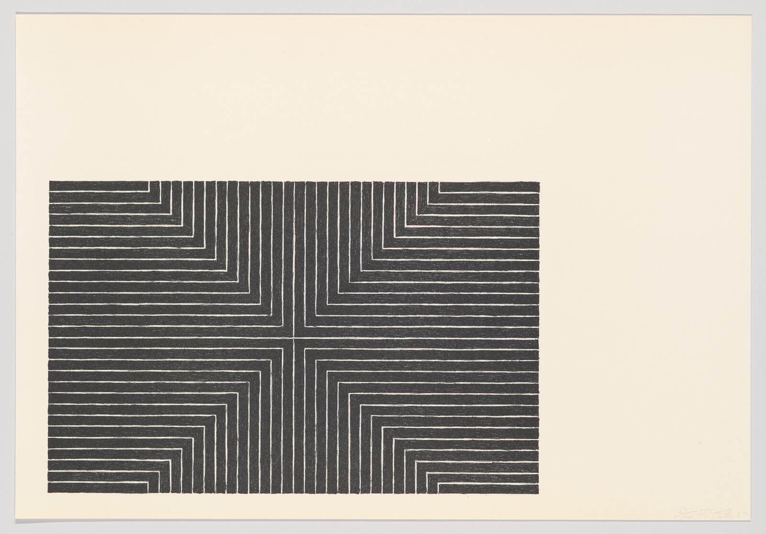
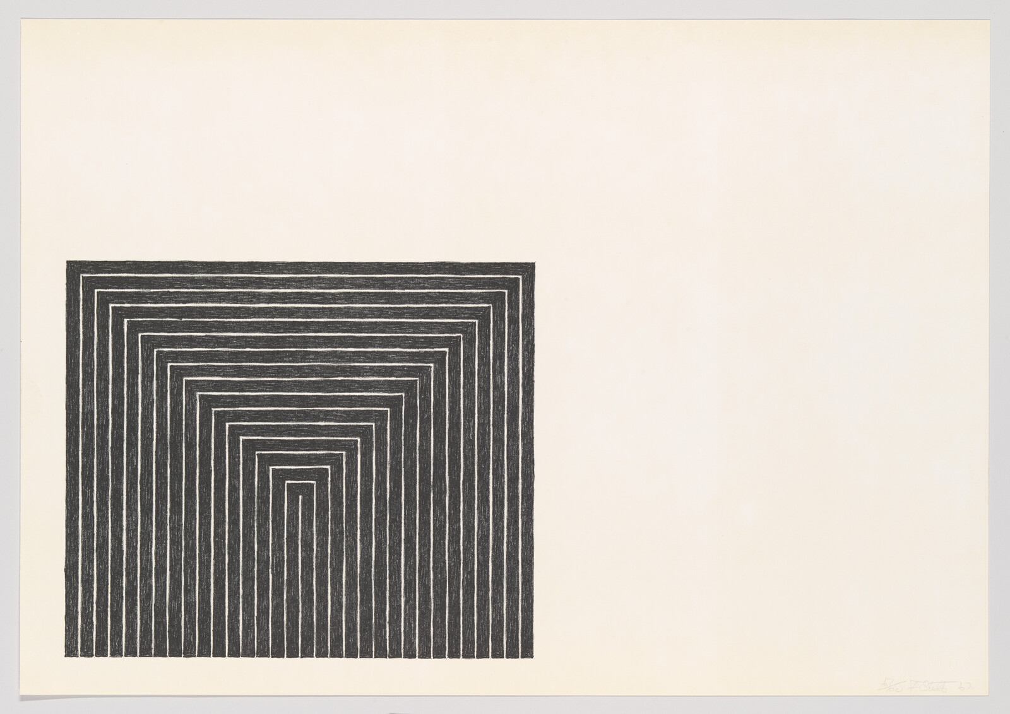
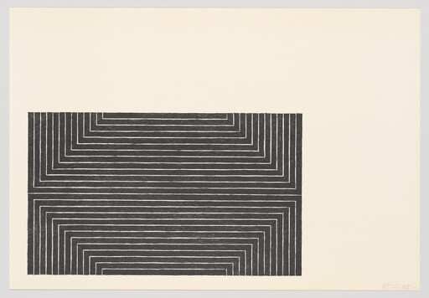
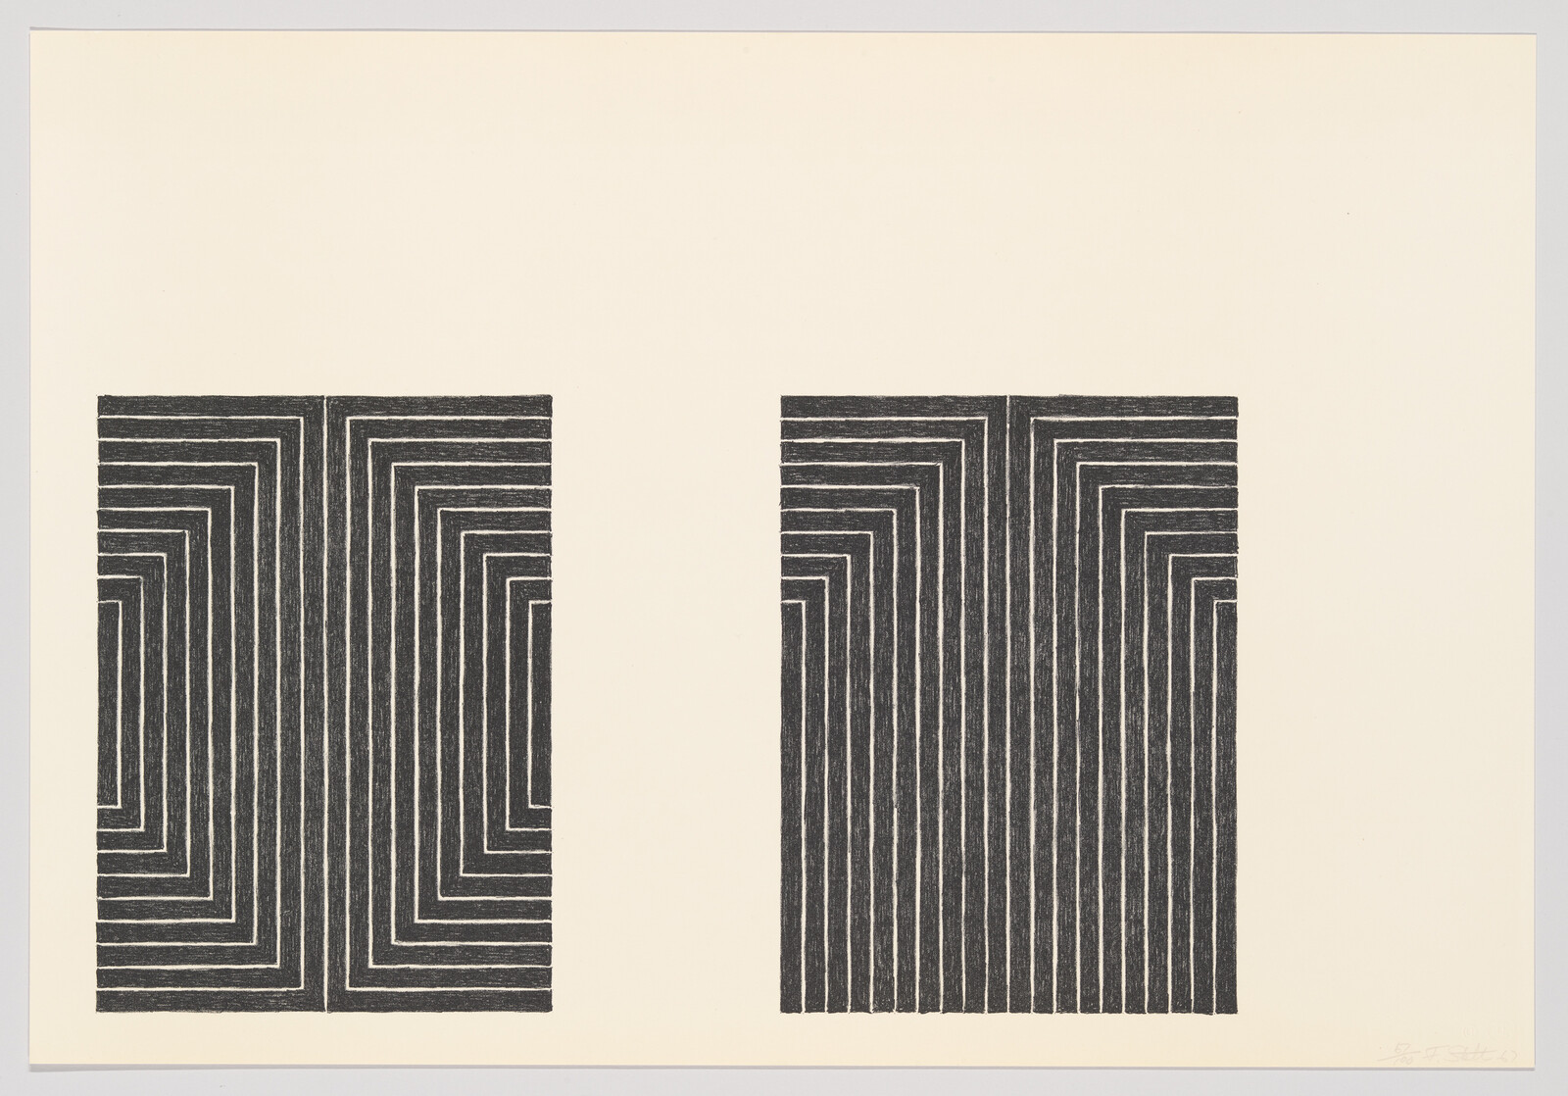
Examples of Minimalist Series
Blanco y Verde (1959), Carmen Herrera
Chatham Series (1971), Ellsworth Kelly
Black Series I (1967), Frank Stella

Slide 12
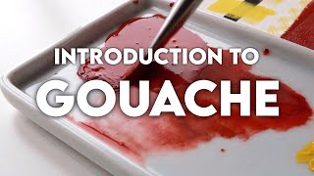

Slide 13
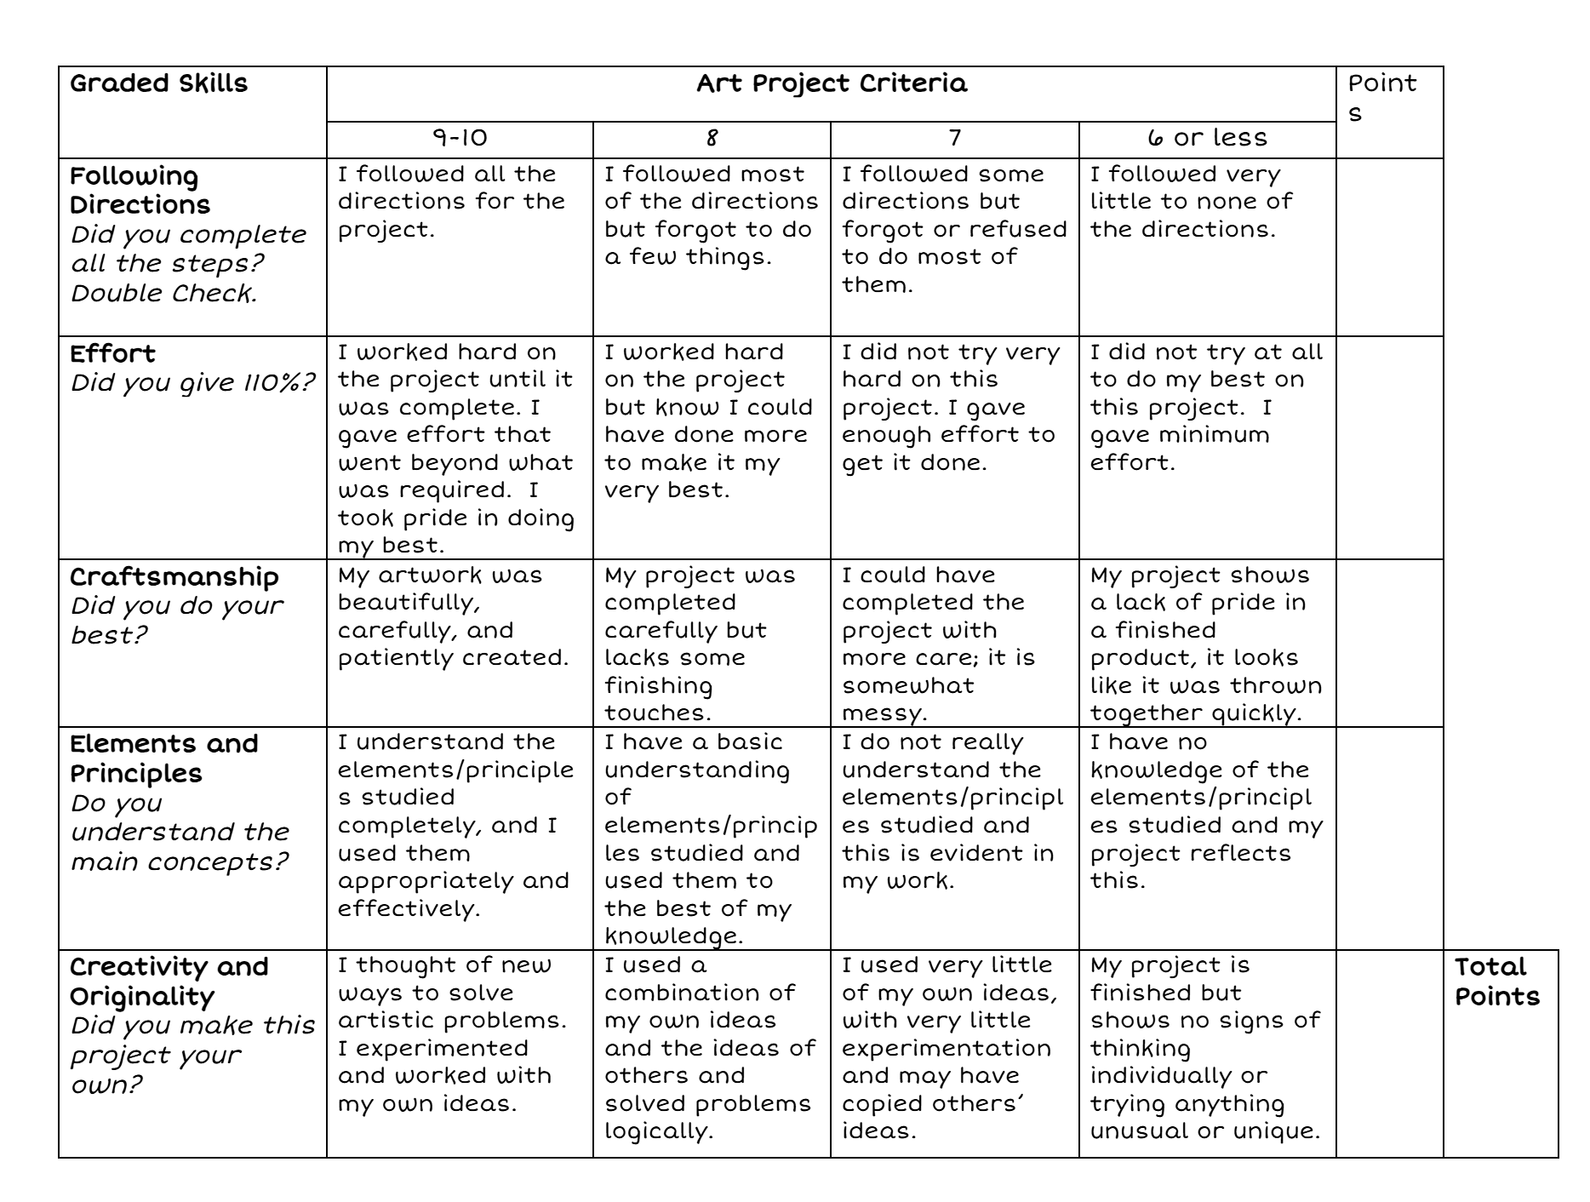
Rubric

