Slide 1
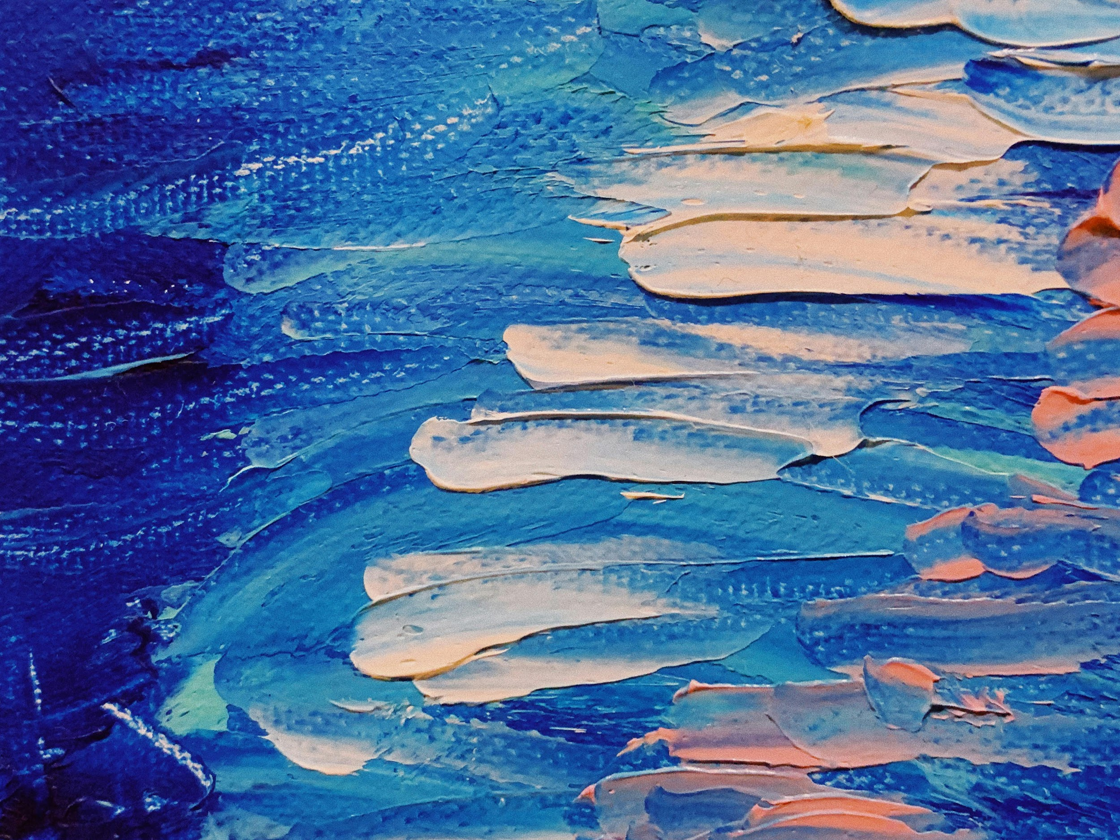
Impressionism

Slide 2
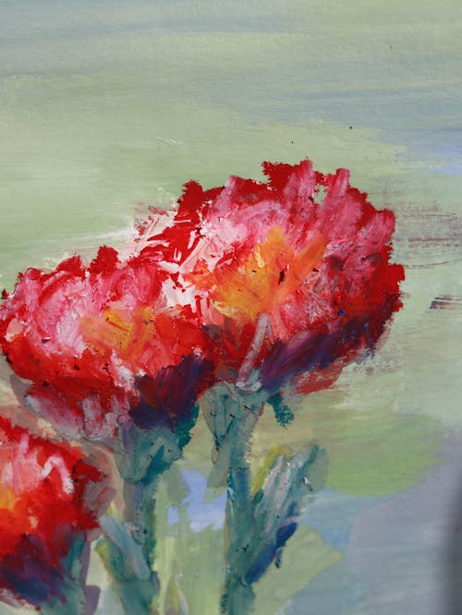
Exercise #1
Set up your station to include the following:
  Red, blue, yellow, brown, and white acrylic paint
  Water cup
  6 pieces of small canvas board
You will have 5 minutes to paint the following 3 images to the best of your ability

Slide 3
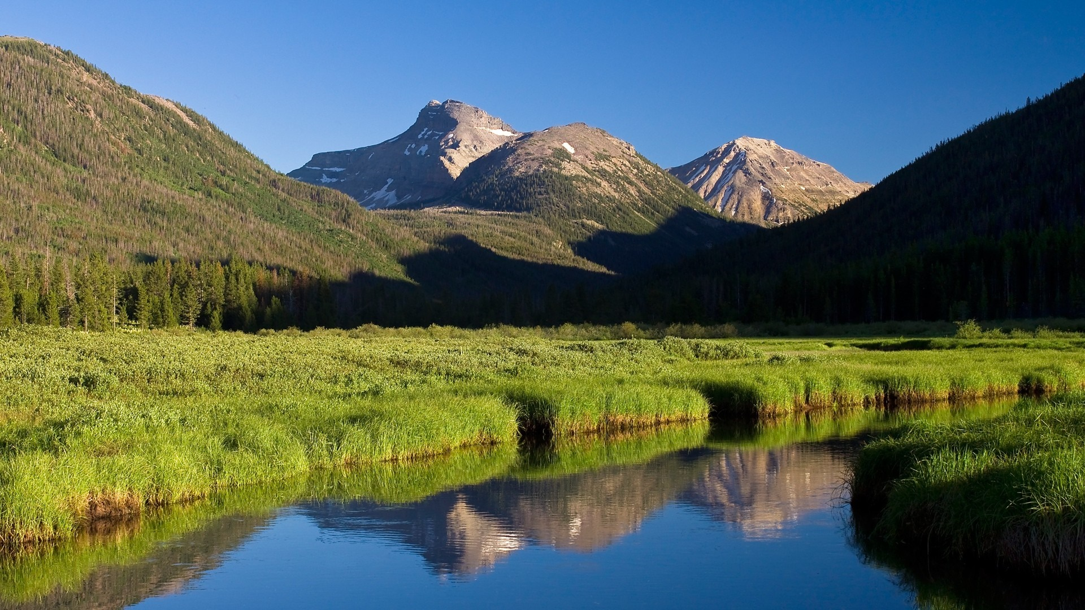
Image #1

Slide 4
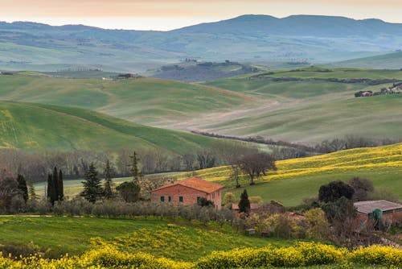
Image #2

Slide 5
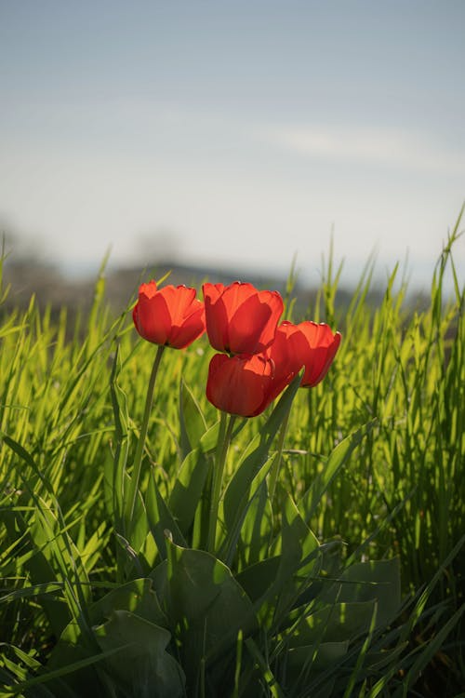
Image #3

Slide 6
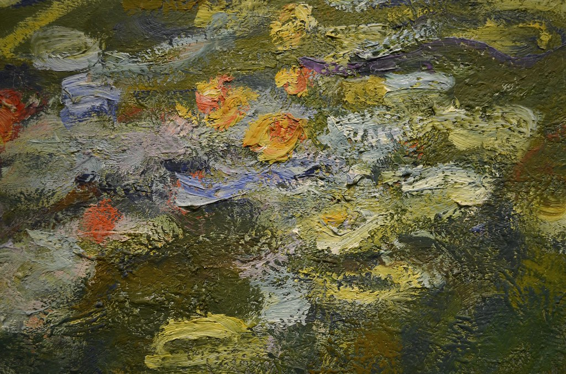
Developed as a revolt traditionalism; considered radical at the time
Sought to portray the world through lens of personal experience by capturing nature and contemporary life
Characterized by loose brush strokes, lack of transition shades, and a sense of impermanence (the “impression” of a moment)
What is Impressionism?

Slide 7
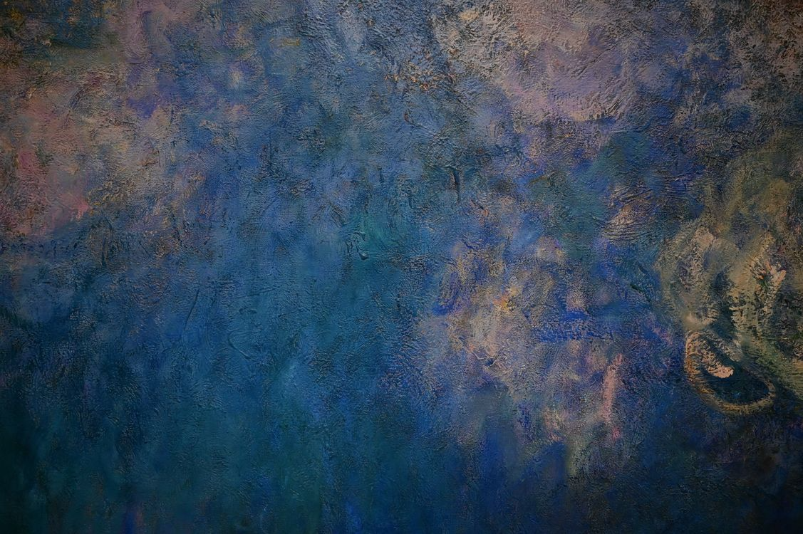
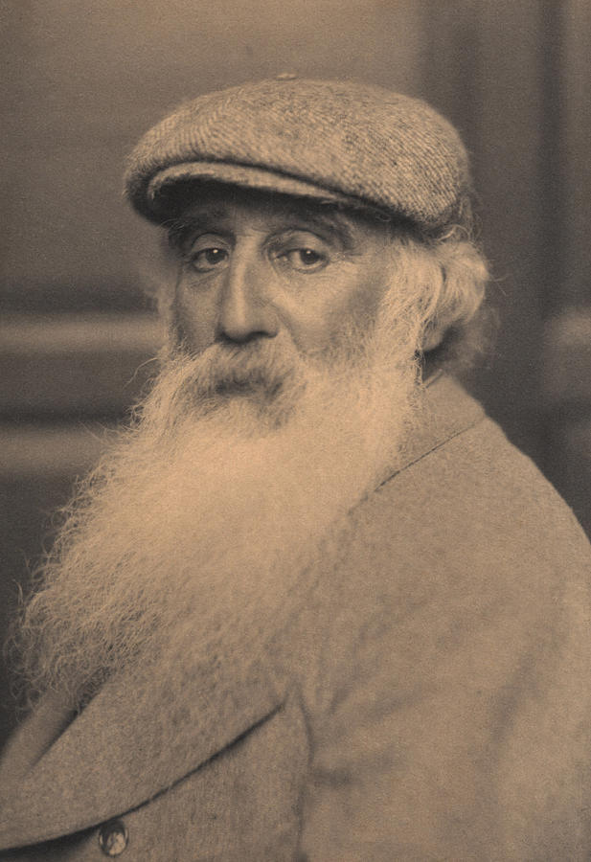
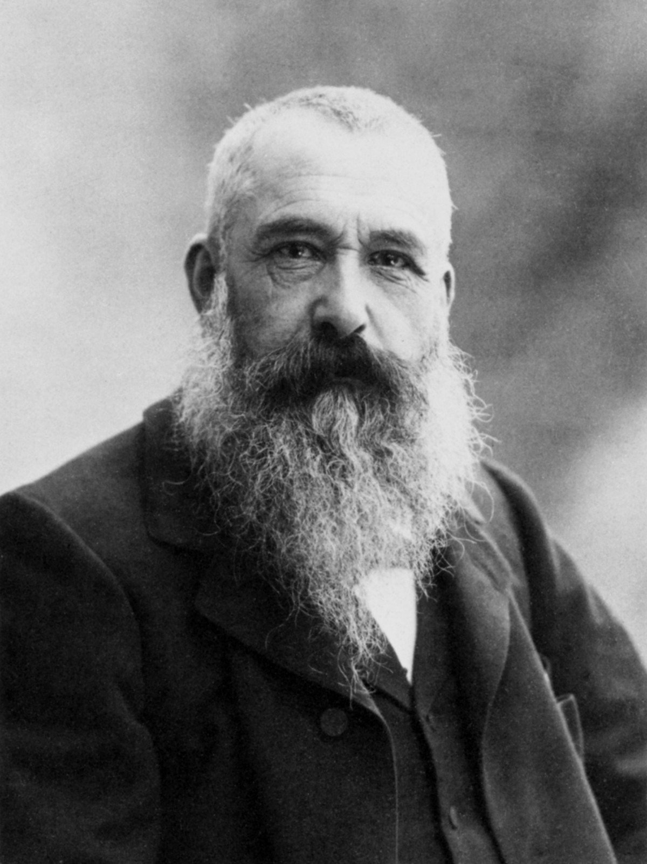
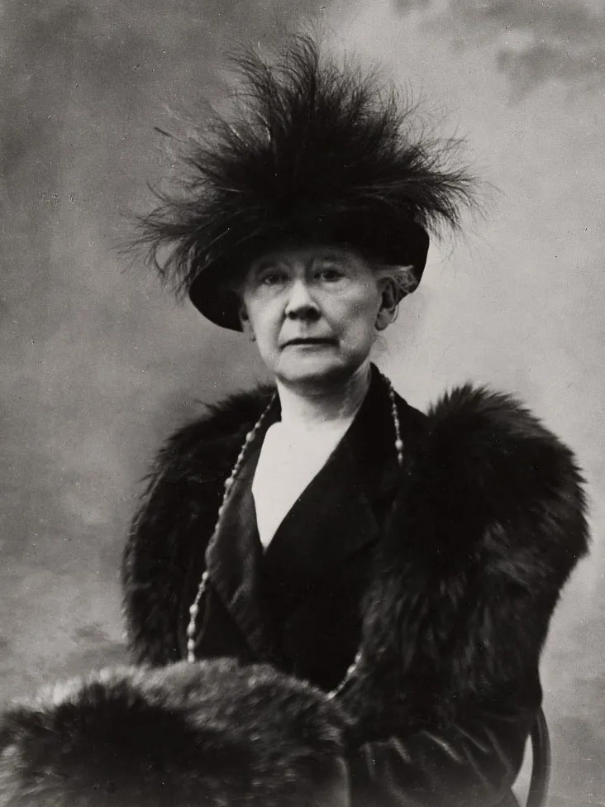
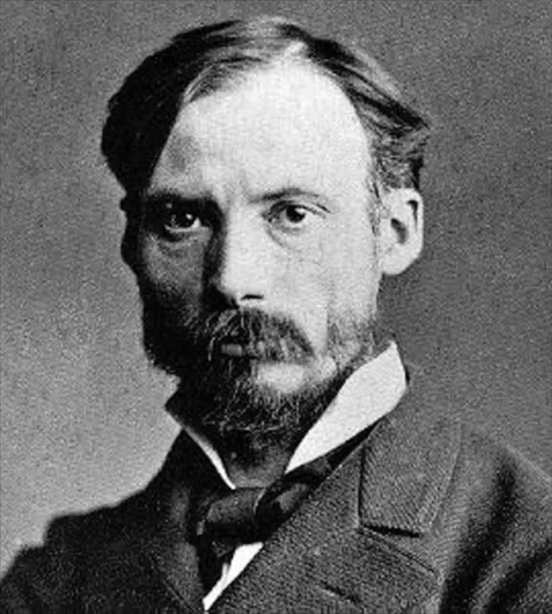
Camille Pissarro
Claude Monet
Mary Cassatt
Pierre-Auguste Renoir
1830-1903
1840-1926
1844-1926
1841-1919
-Known for his depictions of day-to-day life and French peasants
-One of the first artists to experiment with color harmonies through brushwork
-Leader of Impressionism
-Emphasized color and the effects of light rather than depicting figures in a realistic manner
-Only American artist to exhibit with Impressionists in France
-Depicted women, mothers, and children in everyday life
-Depicted Parisian modernity and leisure
-Married the optical concepts of Impressionism with the compositional components of the Renaissance in his work

Slide 8
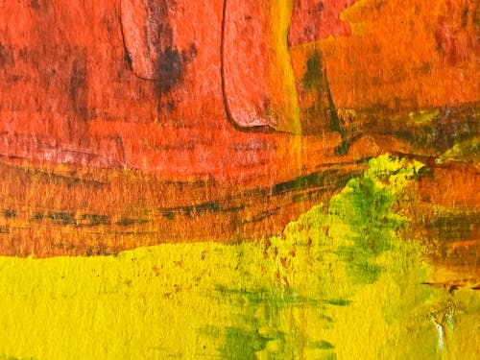
Impressionism: Quick Overview
Impressionist Painting Techniques #1
Impressionist Painting Techniques #2

Slide 9
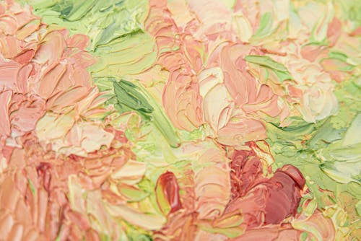
Exercise #2
Using the same materials, you will have 5 minutes to paint the same 3 images from Exercise #1
Use your new knowledge of Impressionist technique to guide your rendering process (shapes or blocks of color, short, loose, brushstrokes, etc)

Slide 10
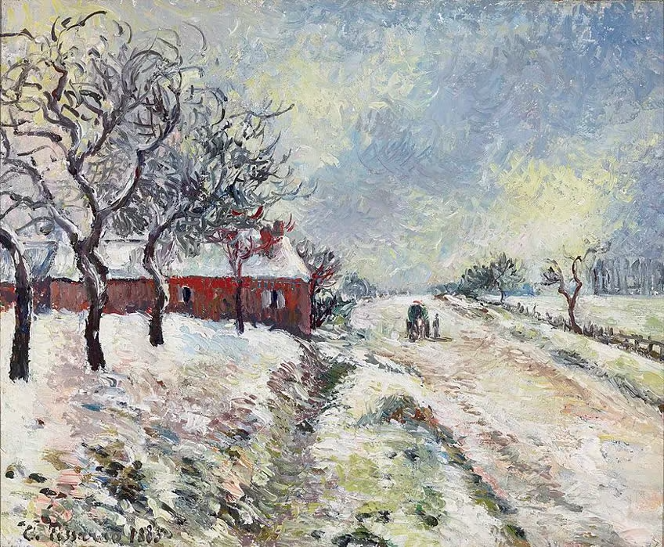
What stands out to you the most in this artwork?
Can you identify the color palette? Is it cool or warm? How can you tell?
What elements are present in this work that are representative of Impressionism?
Snowy Road with House, Surroundings of Erragny (1885) by Camille Pissarro

Slide 11
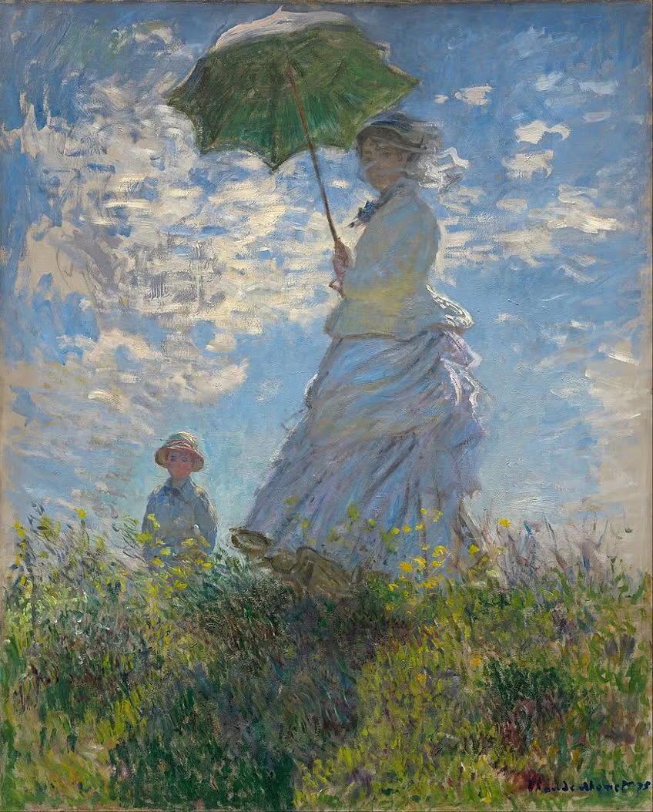
How does this artwork capture the brevity of this particular moment? Think about light, wind, atmosphere, and time of day.
How does this artwork convey everyday life?
How does the composition of this work compare to traditional artworks like those from the Renaissance?
Madame Monet and Her Son Jean Monet (1875) by Claude Monet

Slide 12
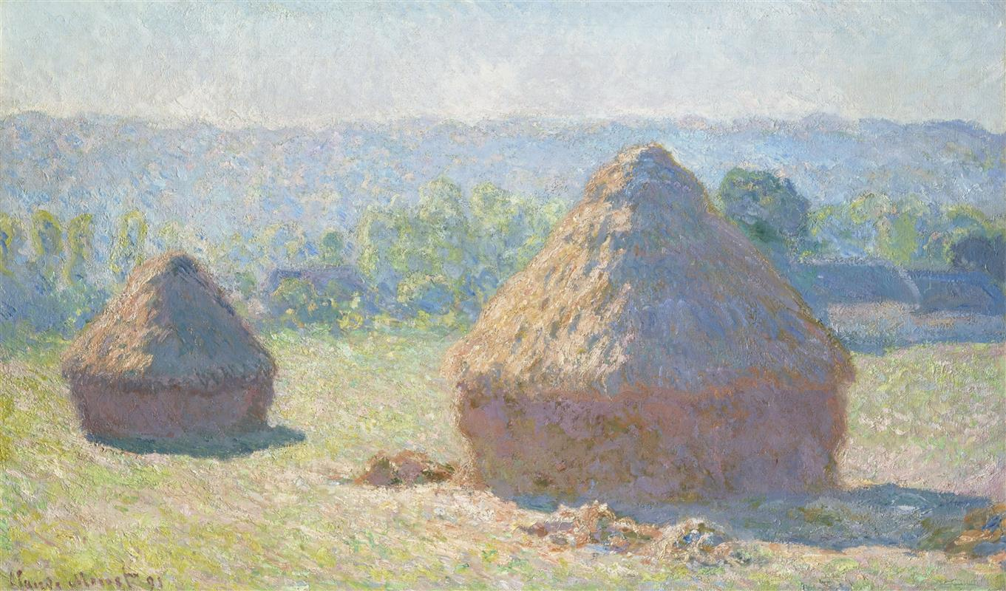
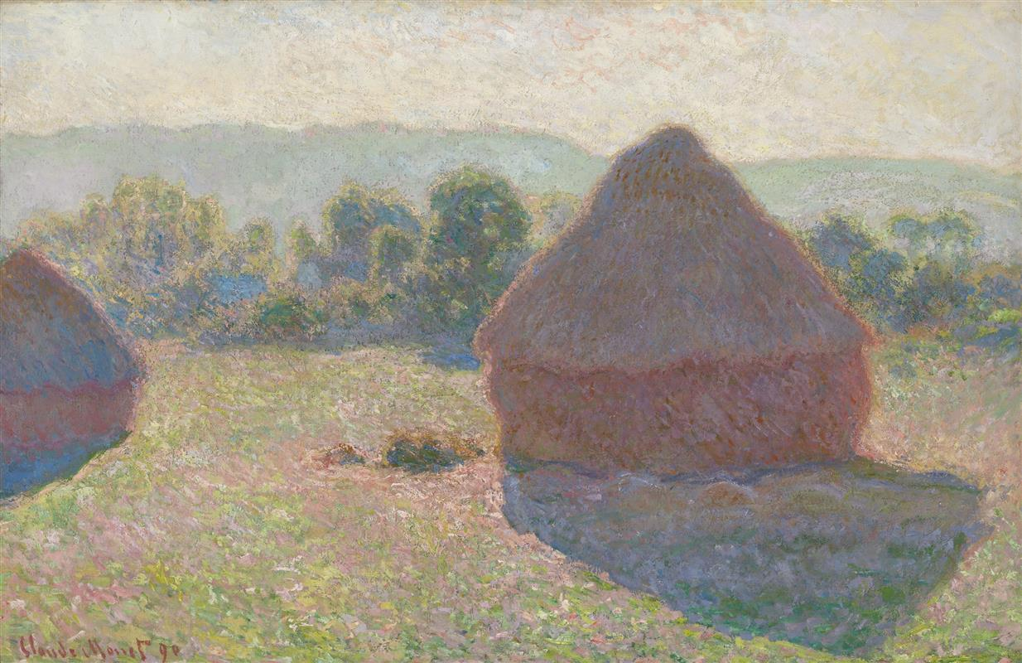
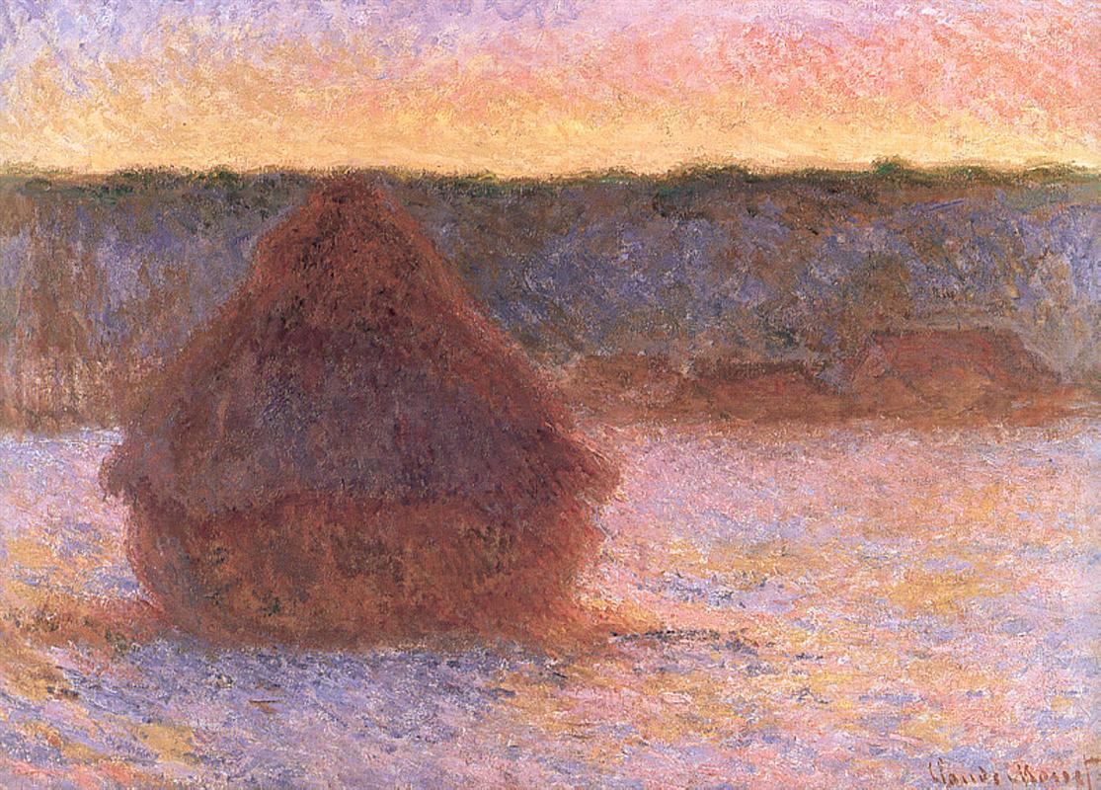
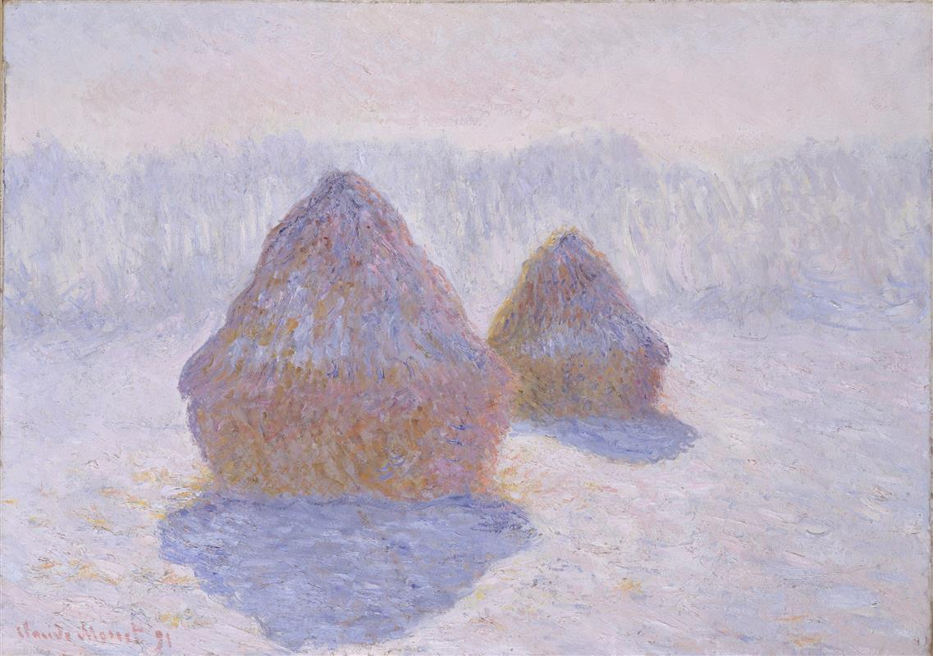
En plein air: the practice of painting outdoors with the subject matter in front of you.
How does the light change the colors of the haystack? Can you guess what time of day each of these were painted based on the lighting and color palette?
What impact would a series like Haystacks have had on the Impressionist Movement?
Haystacks (1890-91) by Claude Monet

Slide 13
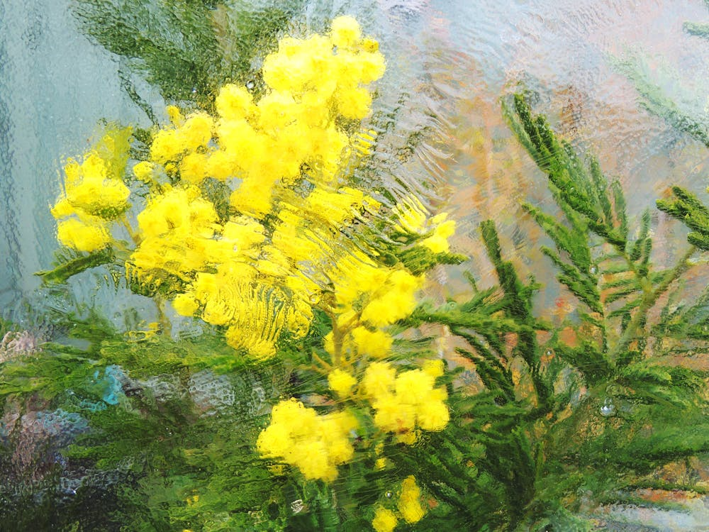
Exercise #3
Gather the following supplies:
  Set of pastels
  Drawing paper
  Clipboard
For today’s class, we will be going outside to “paint” en plein air.
Using your pastels and your new knowledge of Impressionist techniques, pick a vantage point and subject matter to portray.

Slide 14
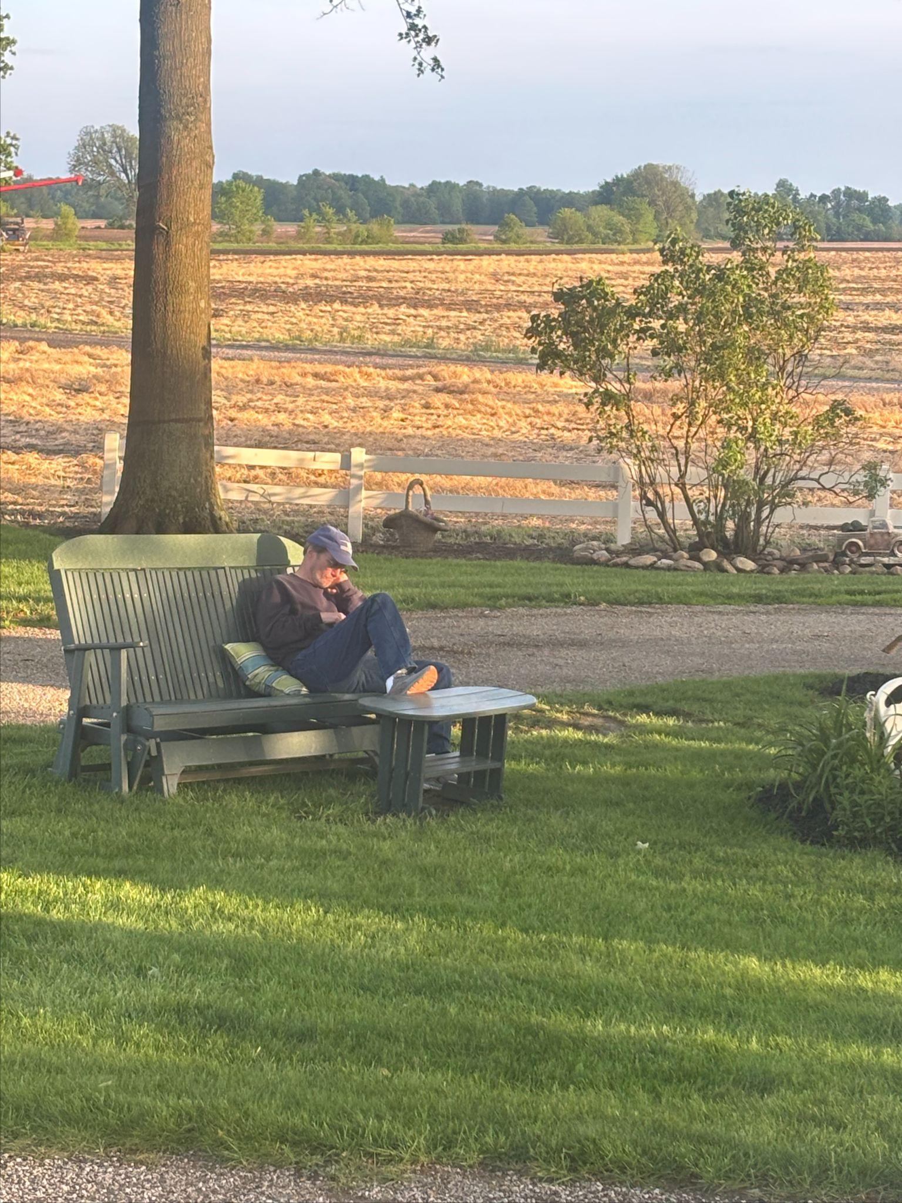
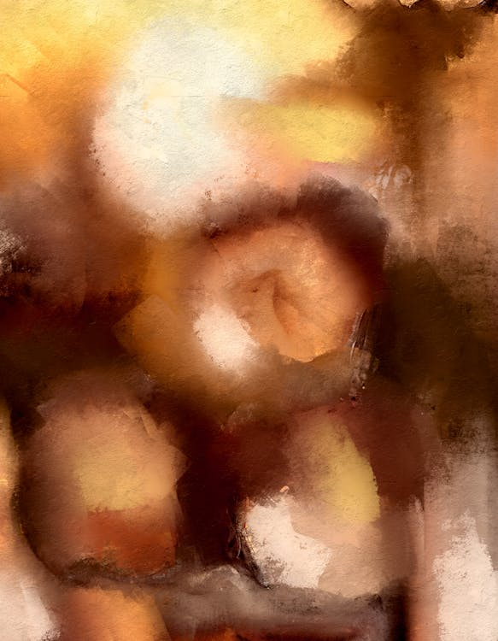
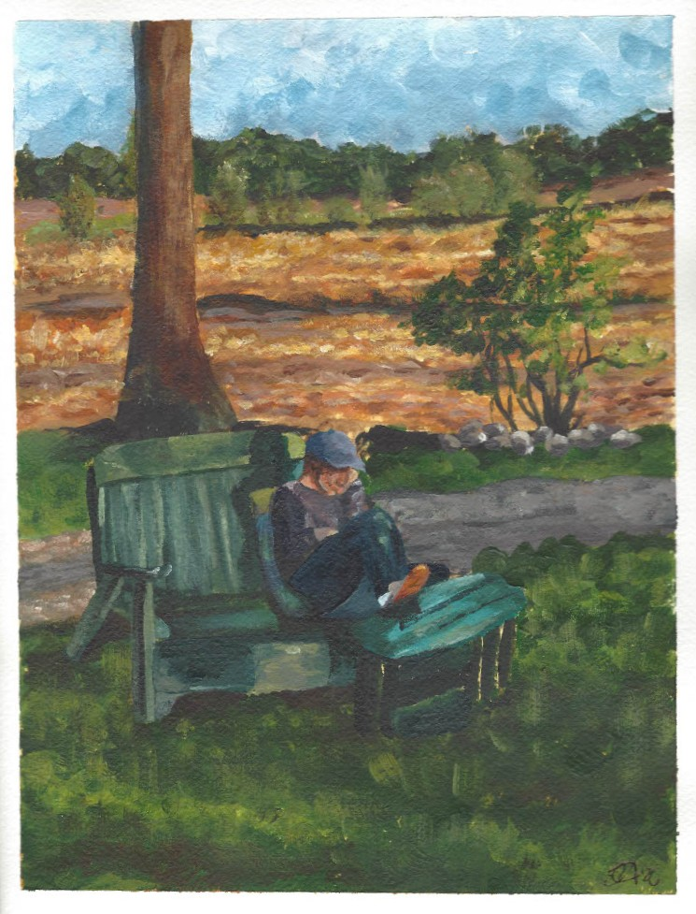
Project Proposal
A hallmark of impressionist artwork was the essence of a fleeting moment. Impressionist artists sought to capture these moments, and with them, their unique light effects.
Using a camera (phone, point-and-shoot, film, etc.), capture your own fleeting moment. This moment can be of anything you find visually captivating, whether that is the color, the lighting, or the subject matter. You MUST take the picture yourself. Then, using your knowledge of Impressionist techniques and ideas, render your image using either pastels or paint.
Reference Photo
Project Example

